Slide 1
Remotely sensing fluvial gas exchange via SWOT

Slide 2
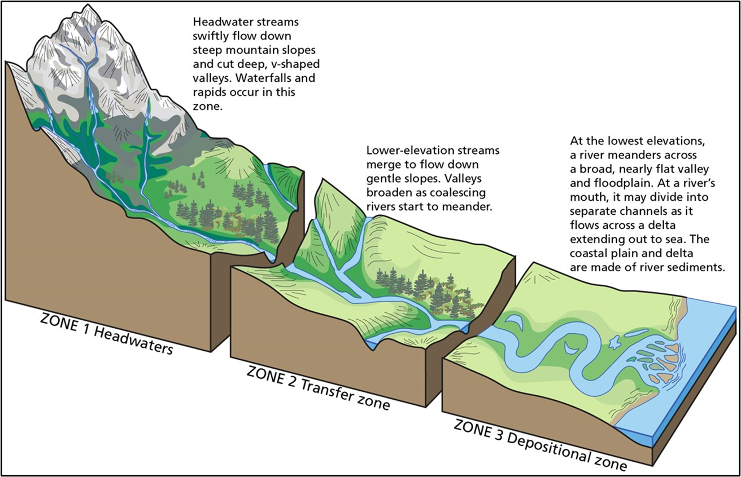
My background
PhD candidate (entering 4th year) with Colin Gleason at UMass
Dissertation on coupling hydraulic geometry theory with large-scale river network models for 2 goals:
1) remote sensing of streamflow
2) gas evasion from river networks
As of 8/30, have NASA FINESST funding to couple these two goals!

Slide 3
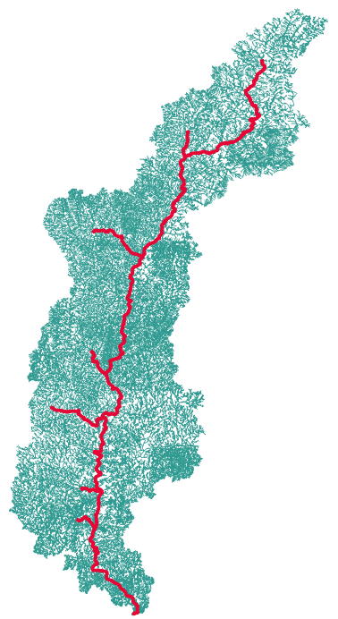
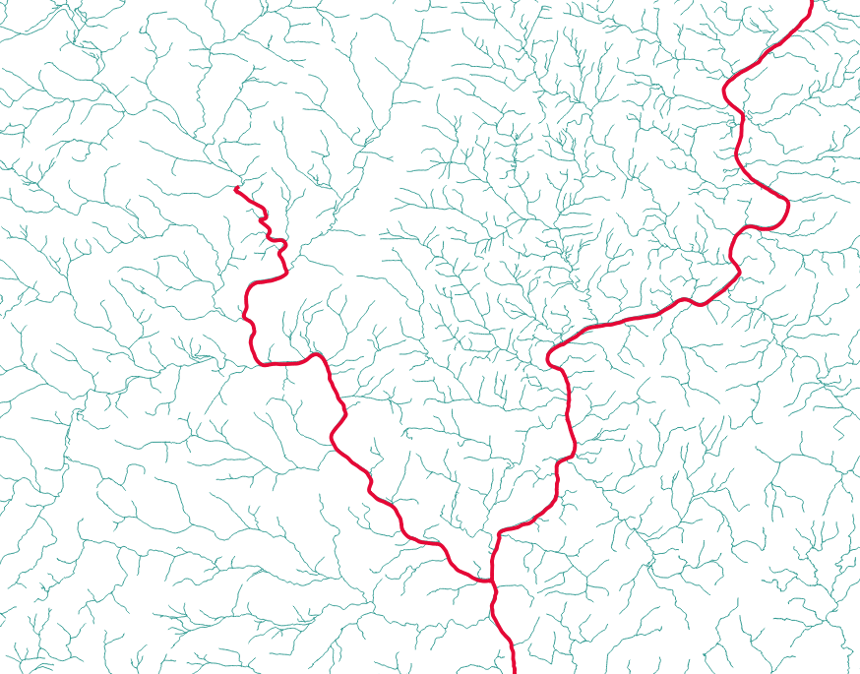
Background: SWOT satellite (launches in 2022)
Measurements:
Water surface elevation/slope
2) River width
Tradeoff:
1) High temporal resolution
-11 day average sampling
-Special 1-day sampling for 6 month calibration in 2022 (including the Connecticut River…)
2) Limited spatial resolution
Rivers > 100m wide (goal is 50m wide)
“Full” CT river drainage network
SWOT-observable rivers
Notes:
The SWOT satellite, launching in 2021, will measure water surface inundation extent and slope in large rivers and lake surface area in large lakes as unprecedented resolution (every ~11 days)
There are some serious tradeoffs. Green is the network used in our model and red are SWOT observable. While this temporal resolution is great, the tradeoff is a very coarse spatial resolution
Future work will look at coupling the transport model presented here with SWOT observations and a CO2 model to begin process-based study of CO2 evasion at the network scale.

Slide 4
Specific Goals
Remote sensing tools are well-developed and are bread-and-butter of Gleason lab
Gleason & Smith 2014
Hagemann et al 2017
Brinkerhoff et al 2020
But, we need to impose a physical model for k
One that works well in SWOT-observable rivers (i.e. wide)

Slide 5
Remote Sensing
-Borrows heavily from decade+ research on RS of streamflow via SWOT [Gleason & Durand, 2020; Hagemann et al. 2017]

Slide 6
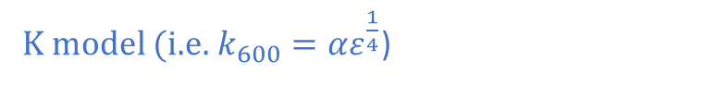
BIKER: ‘Bayesian Inference of the k600 Evasion Rate’ algorithm
What must k600 be, given the SWOT measurements?
K model (i.e.$k_{600}=αε^{\frac{1}{4}}$)
$$p\left(k_{600} | SWOT data\right)=\frac{f\left(SWOT data | k_{600}\right)p\left(k_{600}\right)}{p\left(SWOT data\right)}$$
BENEFITS
Full uncertainty for each k600 estimate
Informed by priors on k600 and the hydraulic terms
Should improve with more data

Slide 7
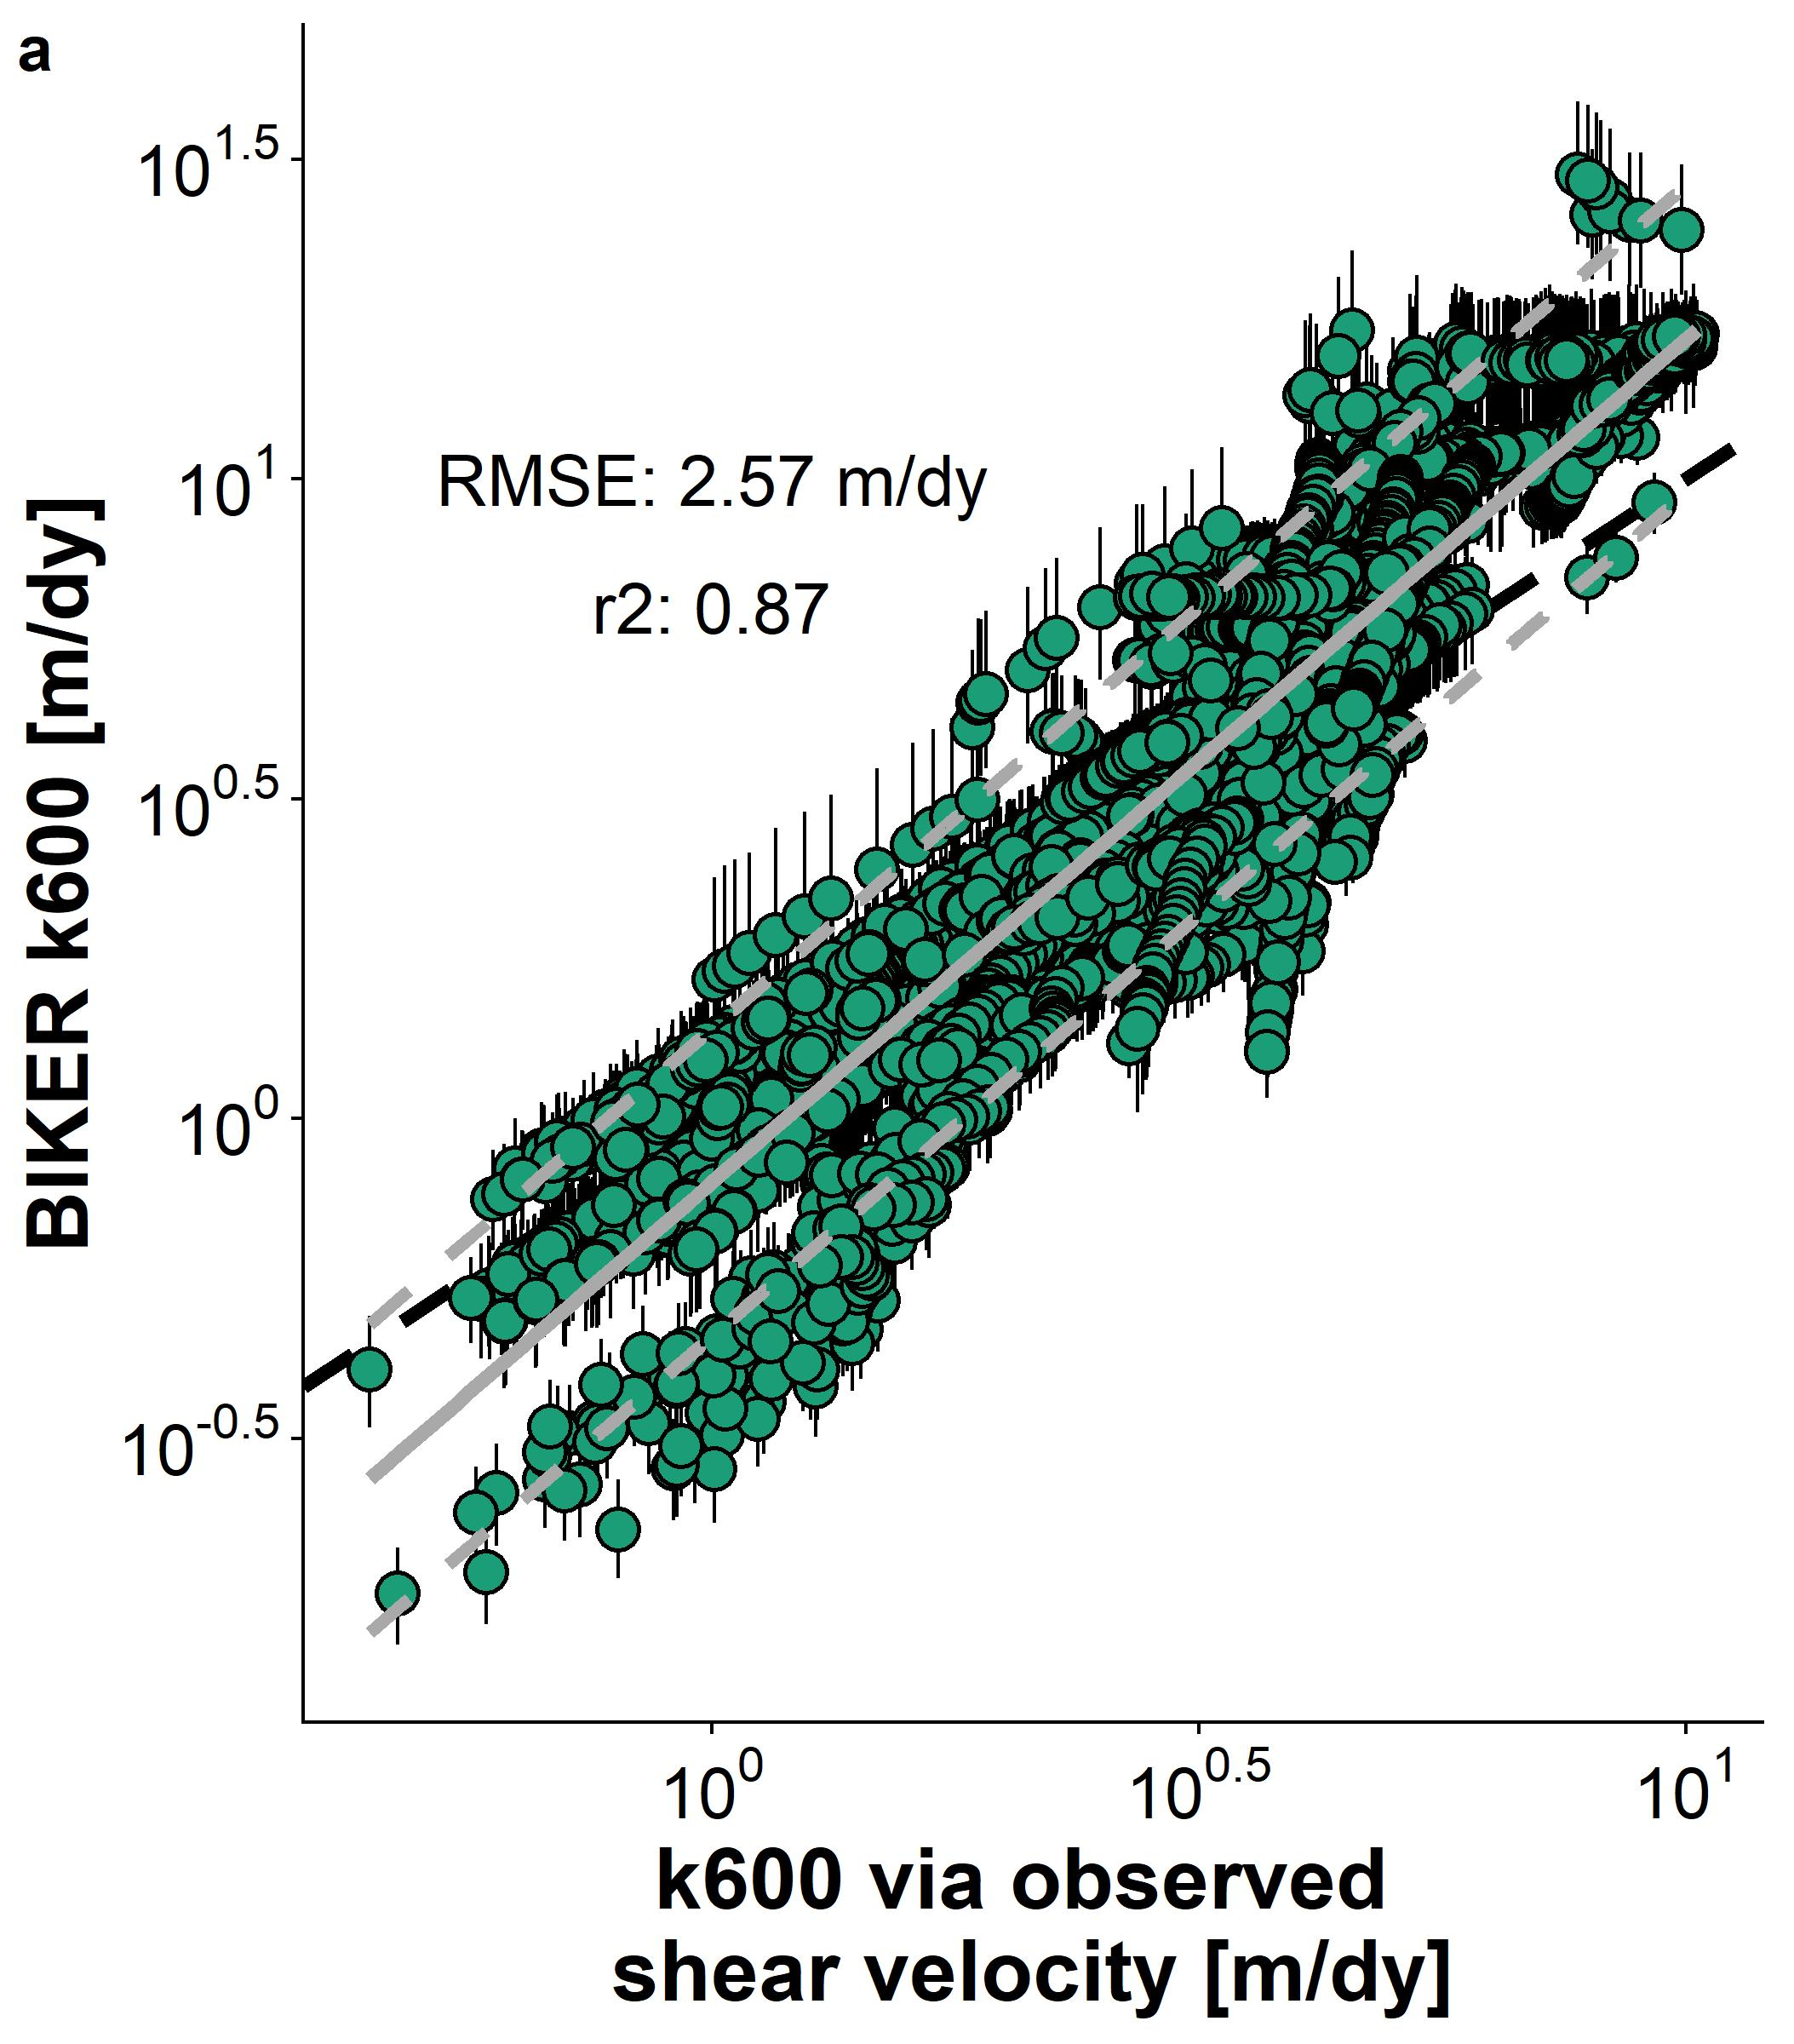
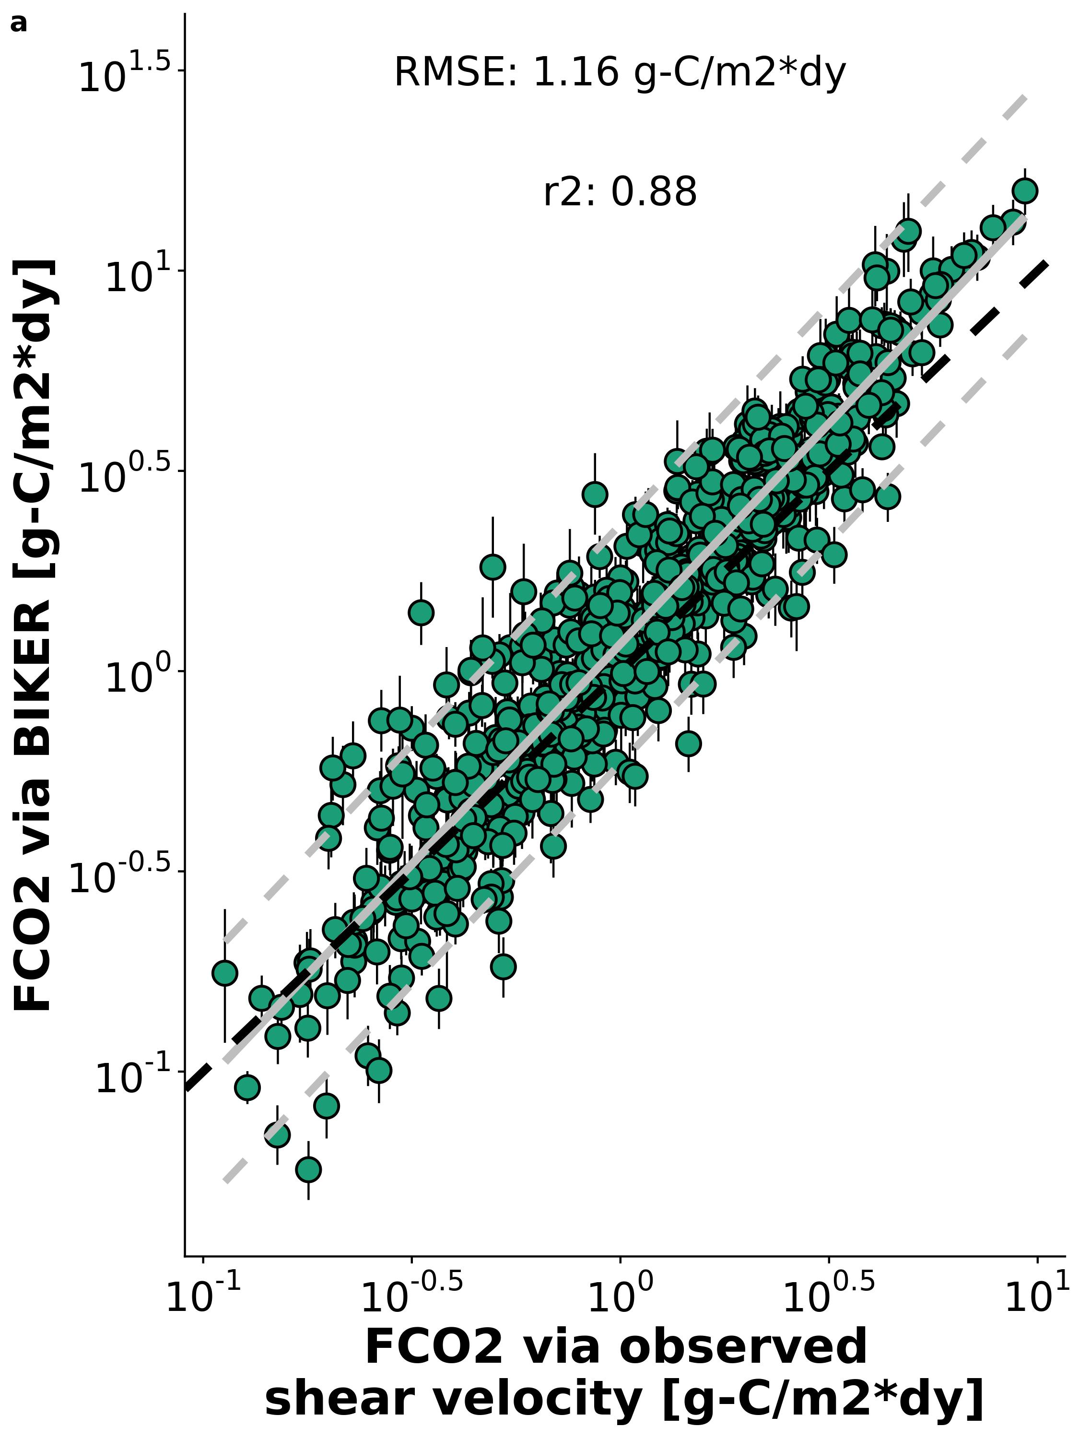
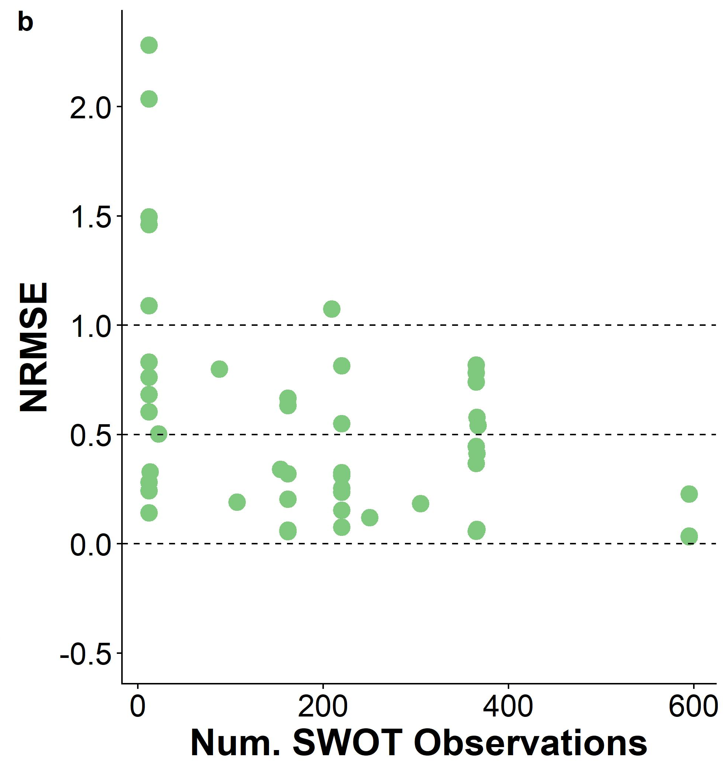
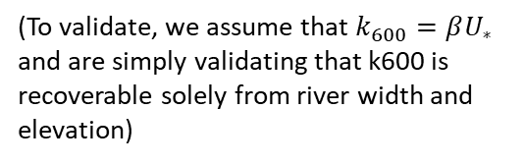
BIKER algorithm validated on 47 simulated SWOT rivers
No in situ info required, obtained from river width and slope only
Performance by river improves with more data, per Bayesian techniques
Coupled with in situ CO2 sensor to see how well we can reproduce the gas fluxes
(To validate, we assume that $k_{600}=βU_{∗}$ and are simply validating that k600 is recoverable solely from river width and elevation)

Slide 8
Imposing a model for k in large rivers
The following analysis uses ~475,000 discrete hydraulic measurements I collected form USGS gauges (Brinkerhoff etal 2019) and the Ulseth etal 2019 dataset of river k600

Slide 9
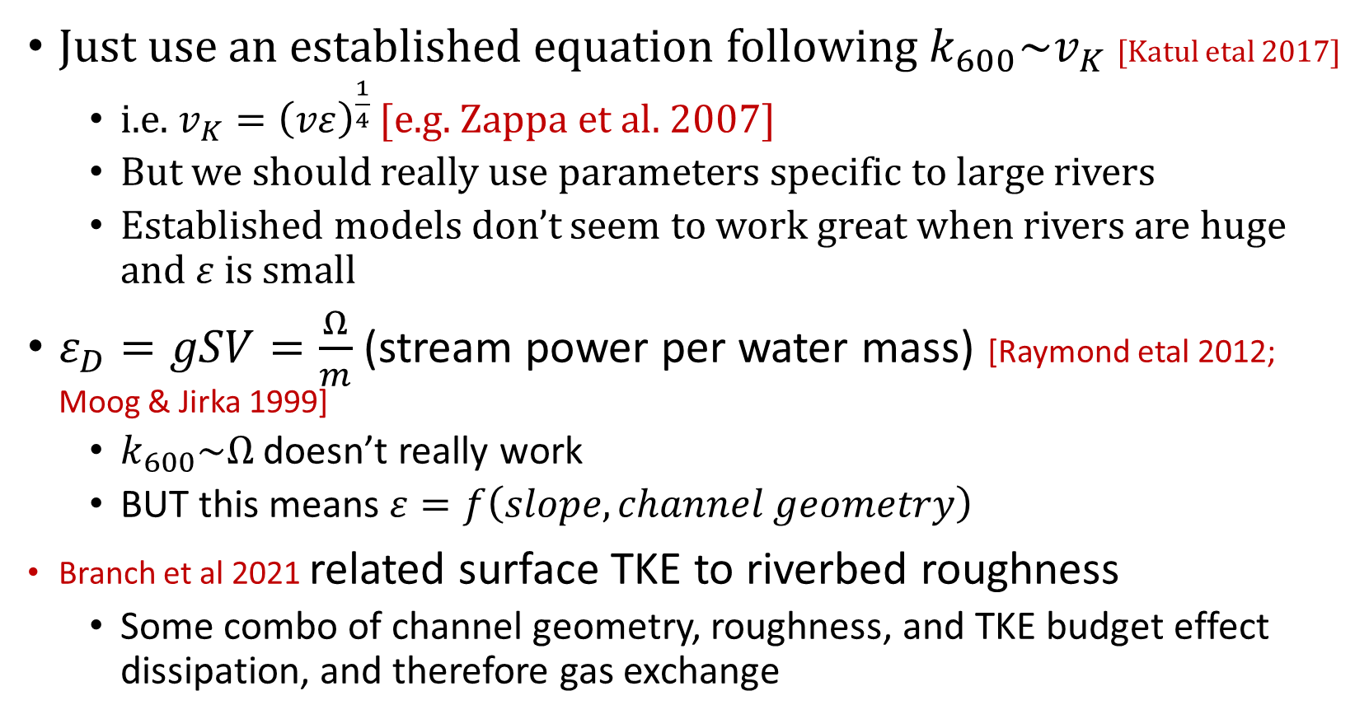
Original Idea
Just use an established equation following $k_{600}\sim v_{K}$ [Katul etal 2017]
i.e. $v_{K}={\left(vε\right)}^{\frac{1}{4}}$ [e.g. Zappa et al. 2007]
But we should really use parameters specific to large rivers
Established models don’t seem to work great when rivers are huge and $ε$ is small
$ε_{D}=gSV=\frac{Ω}{m}$ (stream power per water mass) [Raymond etal 2012; Moog & Jirka 1999]
$k_{600}\sim Ω$ doesn’t really work
BUT this means $ε=f\left(slope, channel geometry\right)$
Branch et al 2021 related surface TKE to riverbed roughness
Some combo of channel geometry, roughness, and TKE budget effect dissipation, and therefore gas exchange

Slide 10
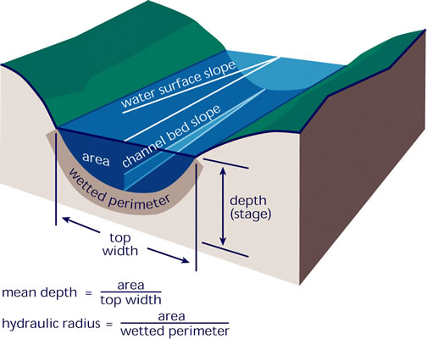
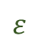
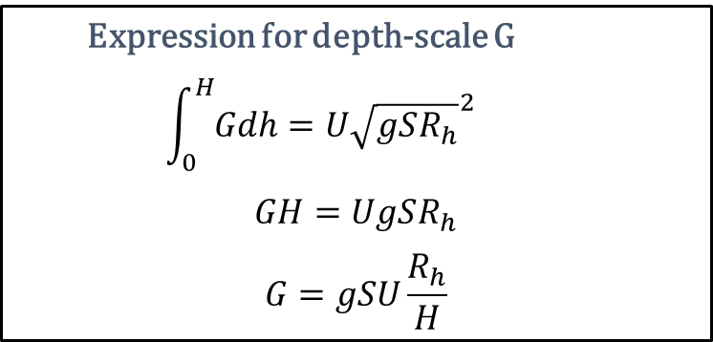
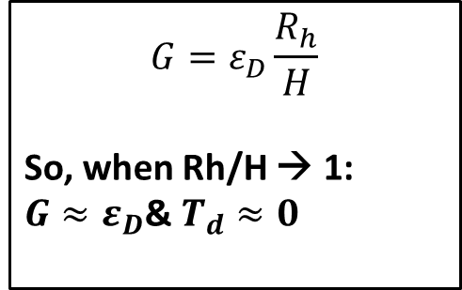
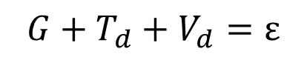
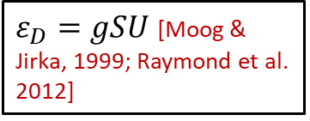
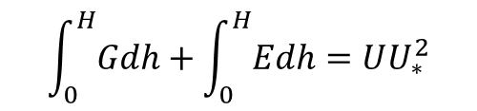
‘SWOT-river’ k model algebra
$$G+T_{d}+V_{d}=ε$$
Nakagawa & Nexu (1993) TKE budget (at free-surface) for an open-channel flow:
Nakagawa & Nexu (1993) also outline model for TKE produced at some depth in the water column:
$$ε$$
h=H
G
$$\int_{0}^{H}{Gdh}+\int_{0}^{H}{Edh}=UU_{∗}^{2}$$
Td
h=0
$ε_{D}=gSU$ [Moog & Jirka, 1999; Raymond et al. 2012]
$$G=ε_{D}\frac{R_{h}}{H}$$
So, when Rh/H → 1:
$G≈ε_{D}$& $T_{d}≈0$
Expression for depth-scale G
$$\int_{0}^{H}{Gdh}=U{\sqrt{gSR_{h}}}^{2}$$
$$GH=UgSR_{h}$$
$$G=gSU\frac{R_{h}}{H}$$

Slide 11
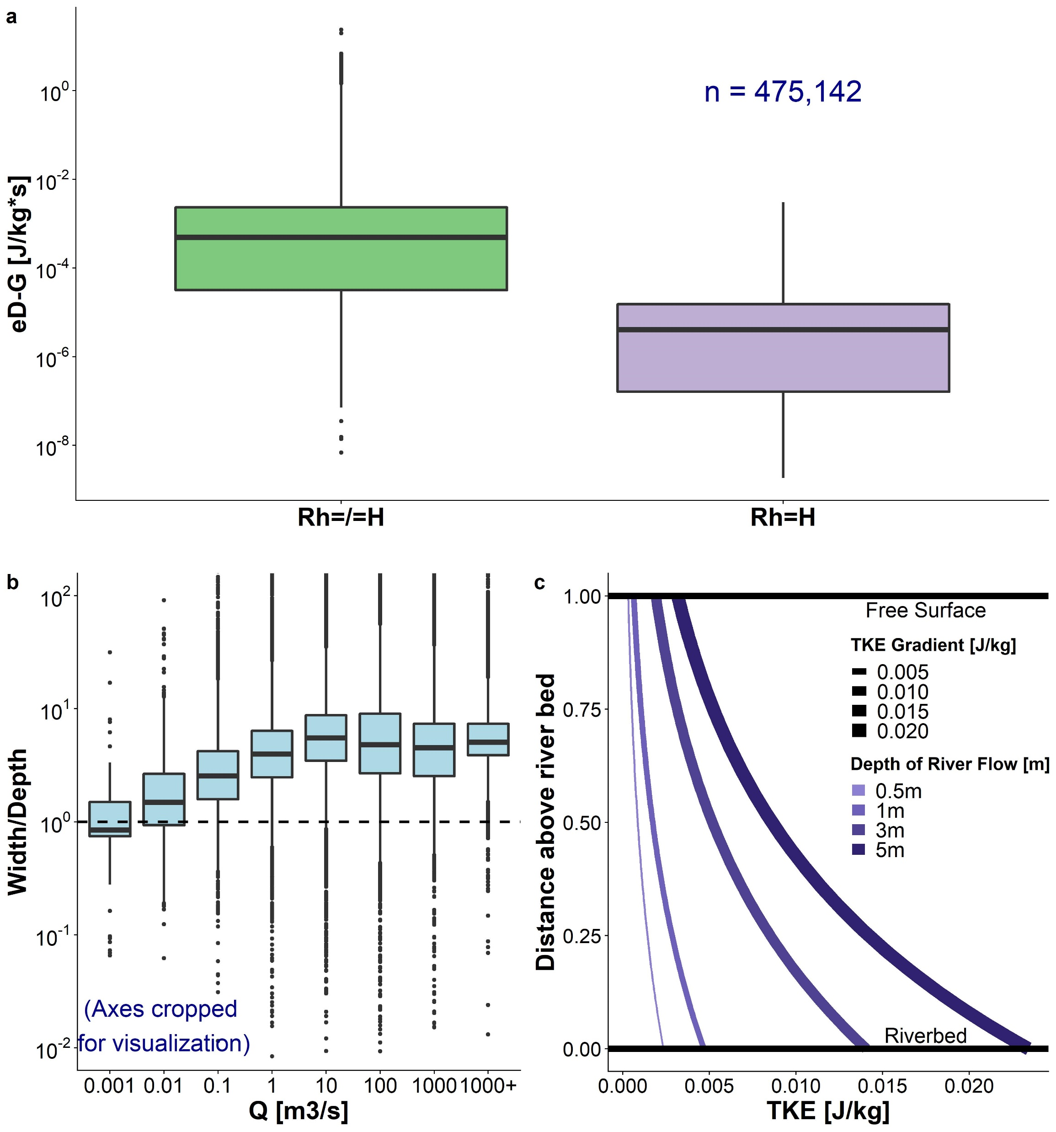
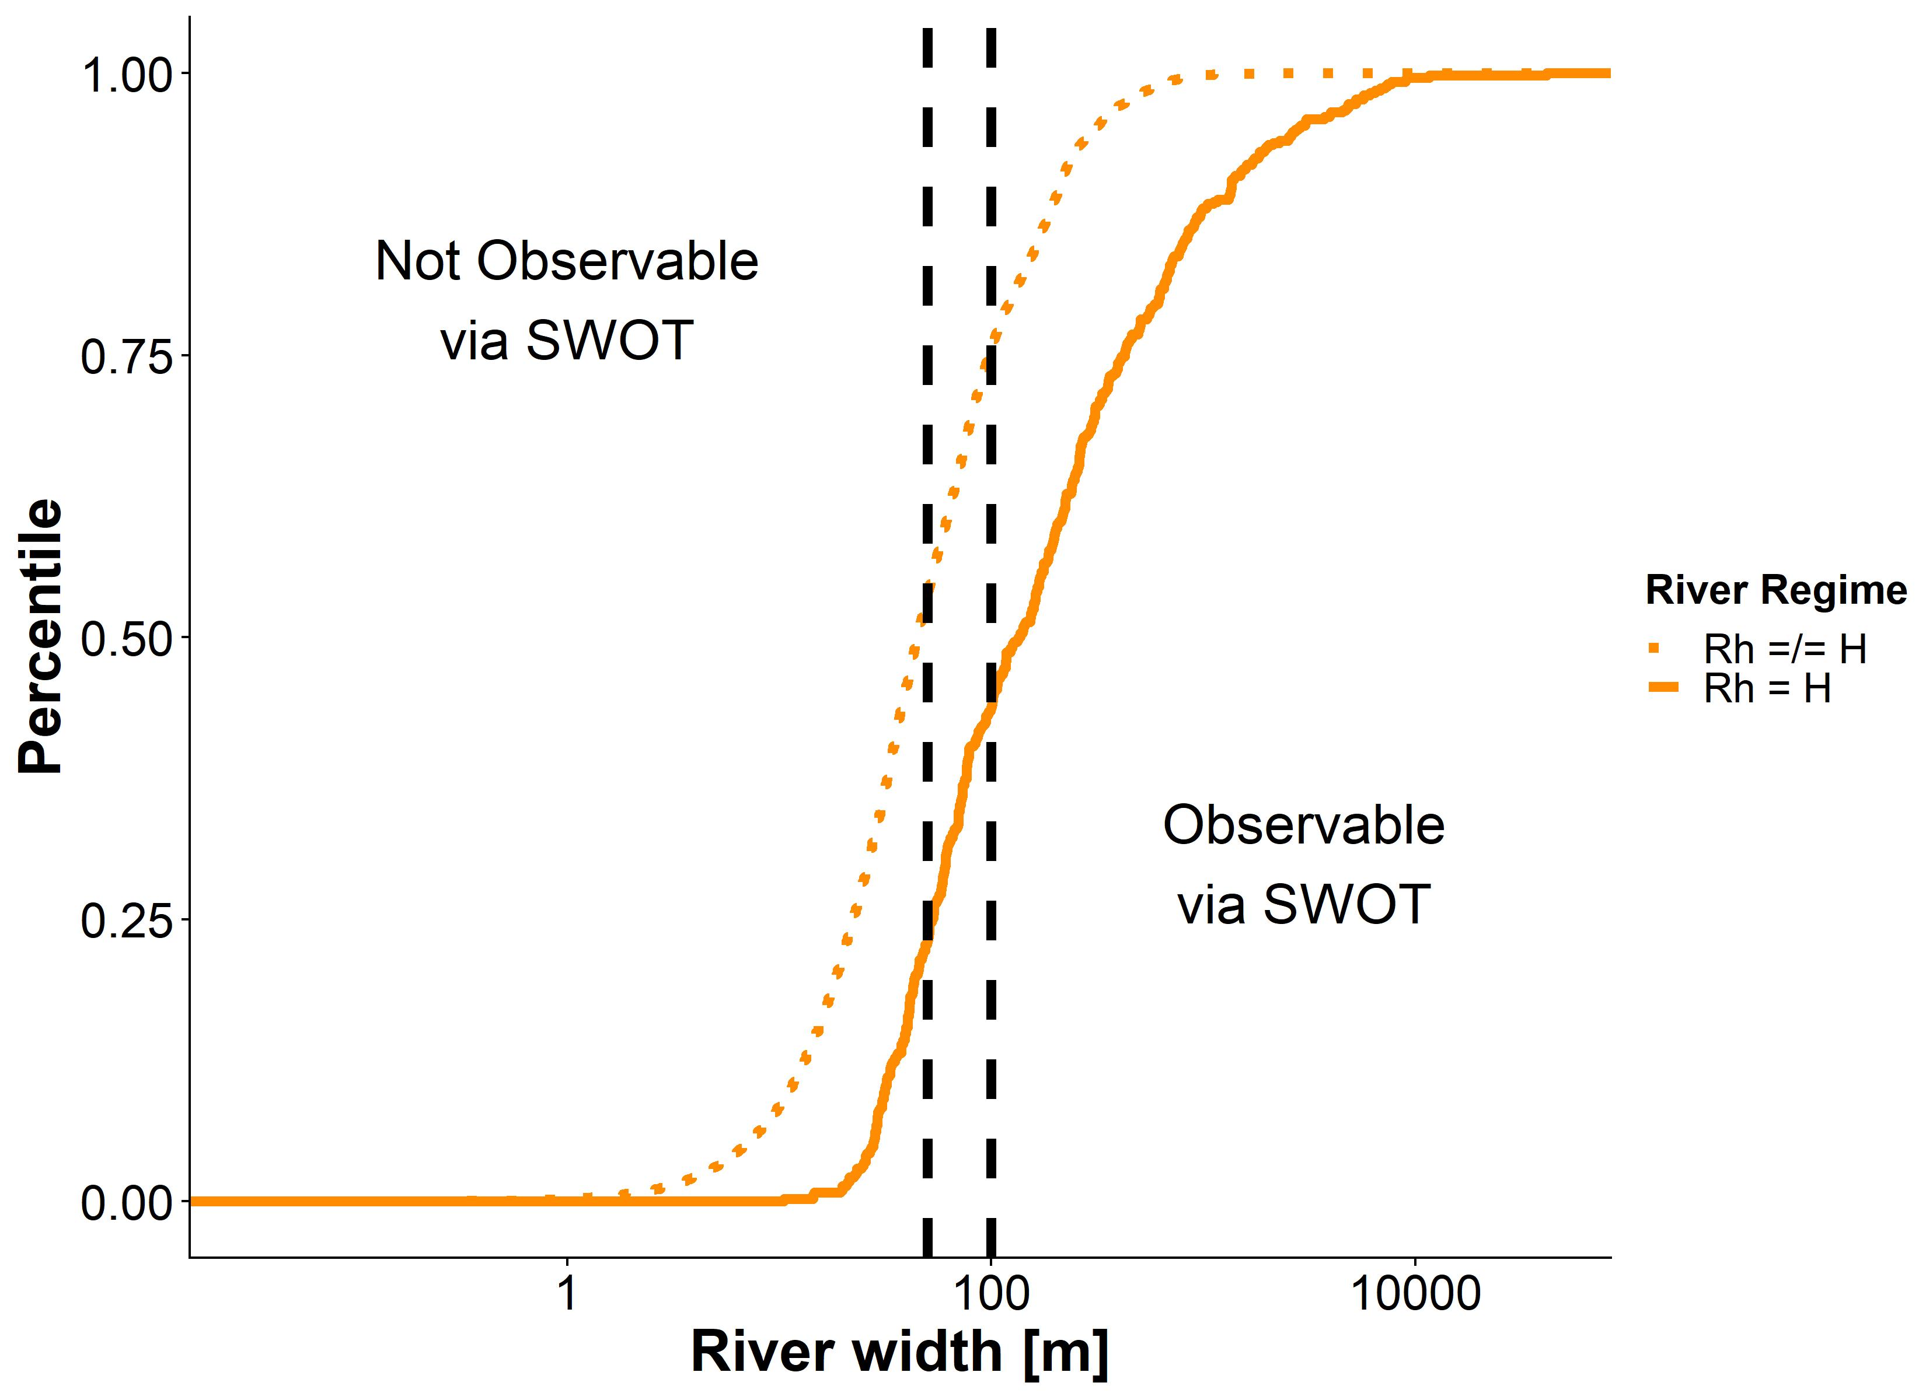


Empirical Validation
2-4 orders of magnitude!
$$G+T_{d}=ε_{D}$$
Happens in nearly all SWOT-observable rivers…
$$G≈ε_{D}$$
If a flow is held constant, but depth decreases (and width subsequently increases), T_{d} decreases
Meaning a very wide, relative to depth, flow will have nearly no T_{d}
(w/in 1%...)
Branch et al 2021 model for TKE

Slide 12
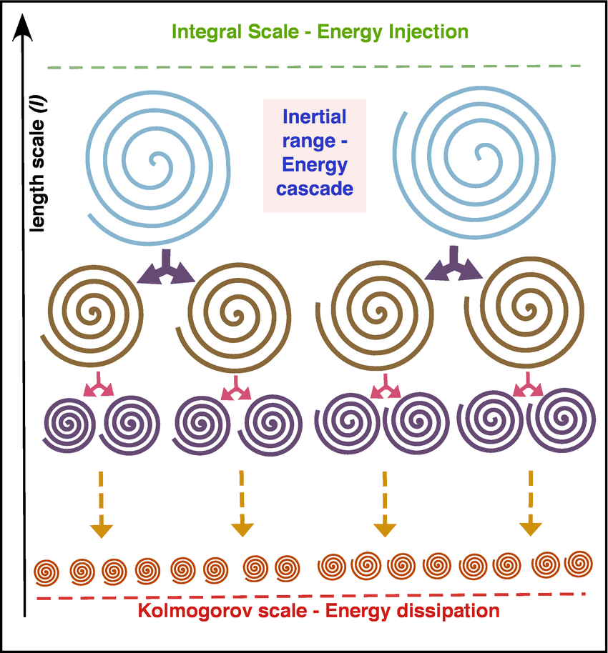
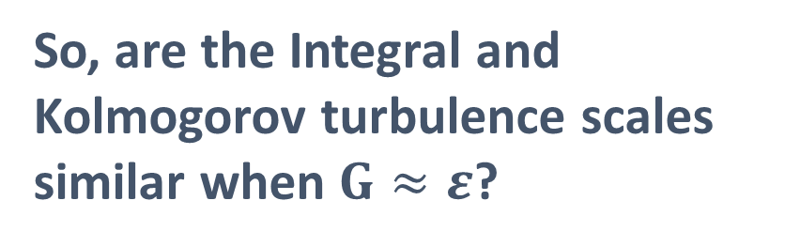
Who cares?
Dissipation is still really difficult to get from SWOT…
“The friction velocity u*, however, can only be an appropriate parameter for estimating interfacial fluxes under the idealized condition of a local equilibrium between the production and dissipation of turbulent kinetic energy in boundary-layer shear flow” [Lorke & Peeters 2006]
So, are the Integral and Kolmogorov turbulence scales similar when $G≈ε$?

Slide 13
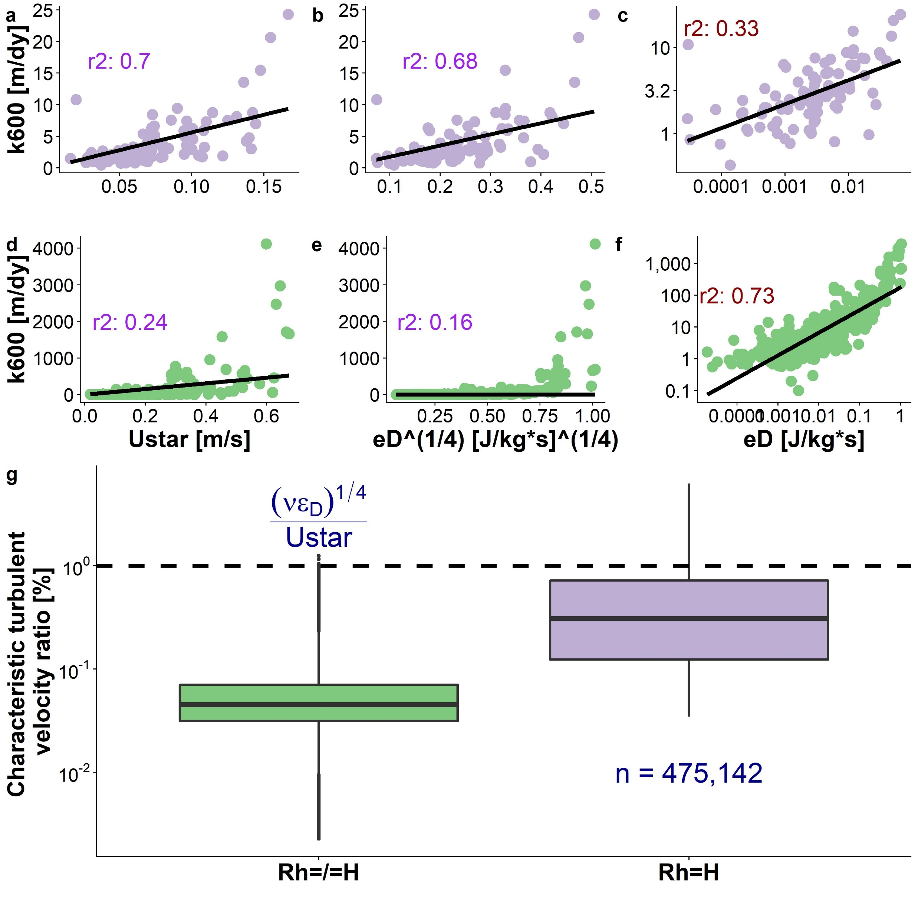
¼ exponent is statistically recovered here, which is really cool (~0.28)
~identical
Data from Ulseth et al. (2019)

Slide 14


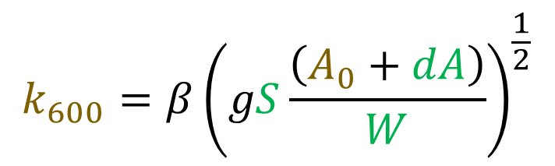
Implication for BIKER
$$k_{600}=βU_{∗}$$
$$k_{600}=β{\left(gSH\right)}^{\frac{1}{2}}$$
$$k_{600}=β{\left(gS\frac{\left(A_{0}+dA\right)}{W}\right)}^{\frac{1}{2}}$$
$$p\left(k_{600}, A_{0} | SWOT data\right)=\frac{f\left(SWOT data | k_{600}, A_{0}\right)p\left(k_{600}, A_{0}\right)}{p\left(SWOT data\right)}$$

Slide 16
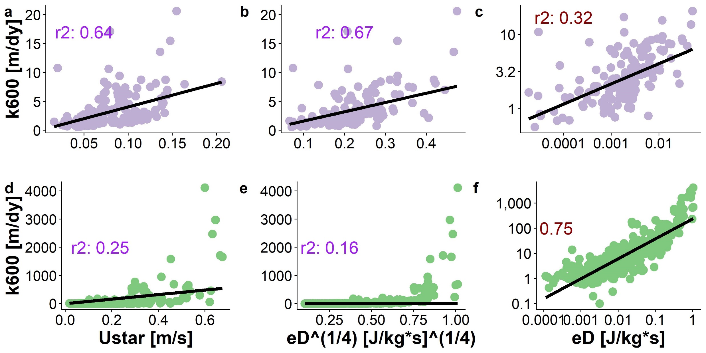
Fitting models by SWOT threshold

Slide 17
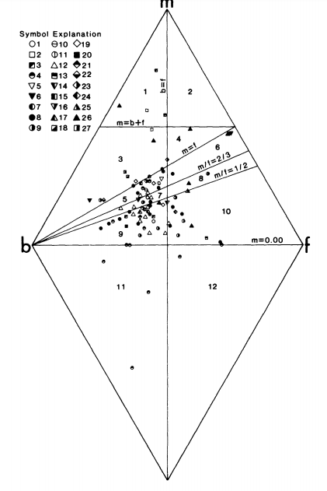
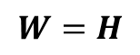


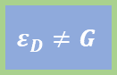
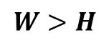
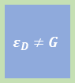
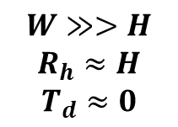
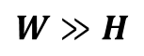
Fluvial TKE controlled by downstream hydraulic geometry
$$ε_{D}≠G$$
Width increases faster downstream than depth does
$$ε_{D}≠G$$
$$W=H$$
$$ε_{D}≠G$$
$$W>H$$
$$ε_{D}≈G$$
$$W≫H$$
$$W≫>H$$
$$R_{h}≈H$$
$$T_{d}≈0$$
Rhodes 1987

